Slide 1
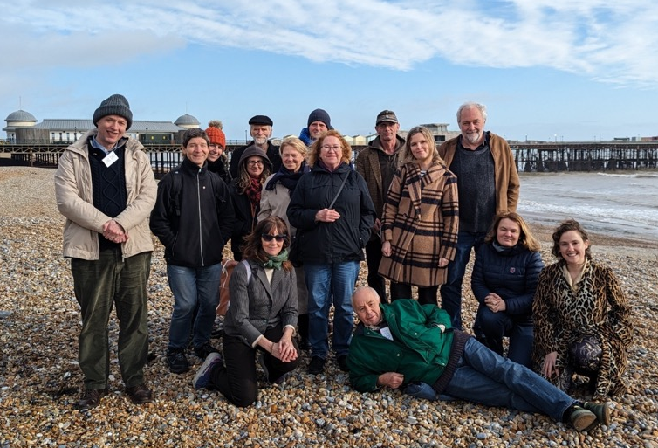
Energise Sussex Coast
Energise Sussex Coast is a community benefit society.
Our mission is to act co-operatively to tackle the climate crisis and energy injustice through community owned renewable power and energy saving schemes.
The Energise Sussex Coast Team
Notes:
MARTIN. Mention community energy. Energy and retrofit. Looking to enable householders to make informed choices, cut through sales, avoid scams etc. Emphasise non profit. No selling, impartiality.... still community led. We are just enablers.

Slide 2
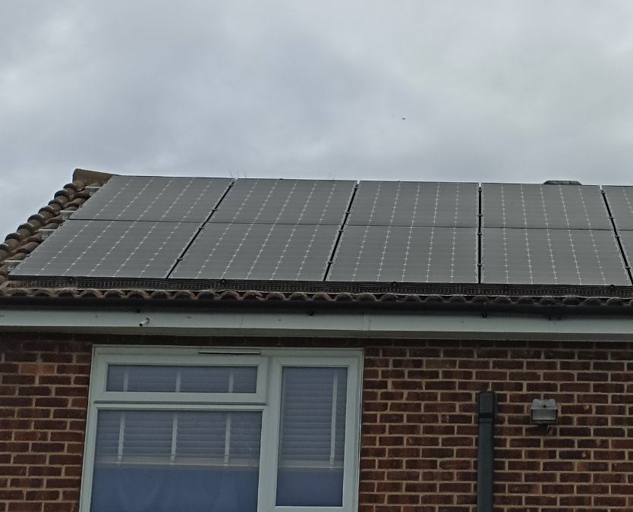
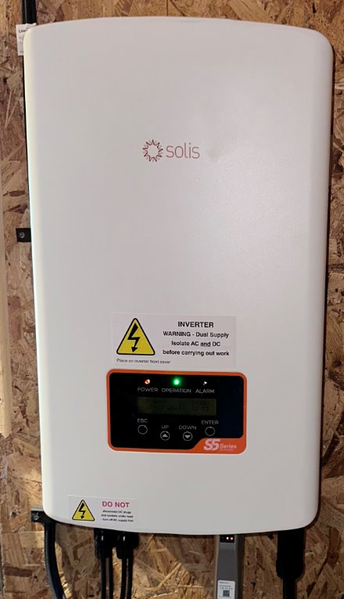
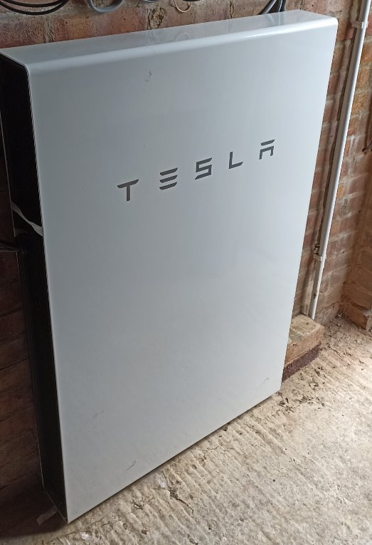
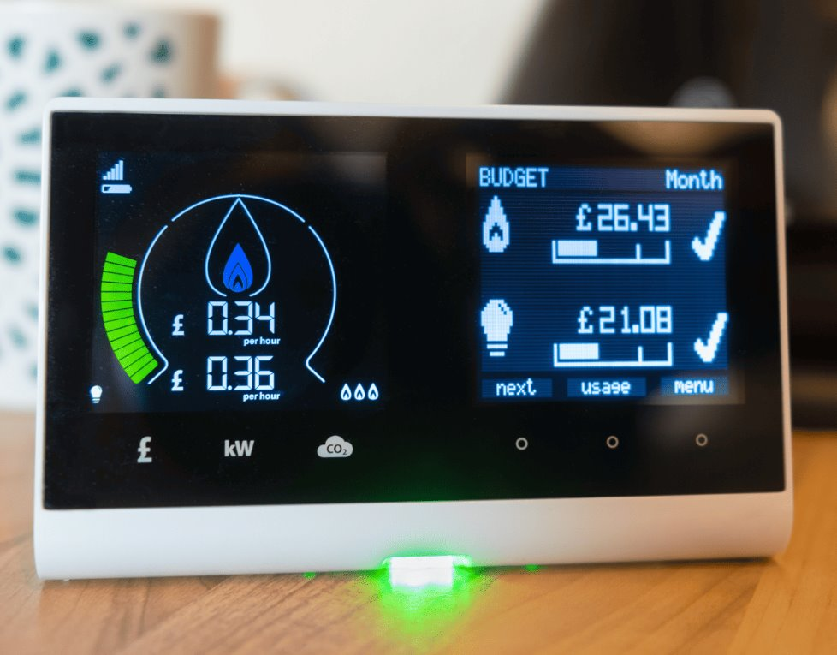
Basic equipment
Panels – photovoltaic (PV) panels produce free electricity. Bird guards stop birds getting under the panels!
Inverter – converts power from the panels to be usable by the house/grid
Battery? - allows you to use more of your generated power (70+% rather than 25-40%)
Smart meter – required to be paid for your excess power
Notes:
olar panels generate electricity that feeds intoyour fuse board and powers thehouse. FUNDAMENTALS
It is a "live generator" and wakes up at first lightand then shuts down at dusk every day.FUNDAMENTALS
System is made up of solar panels and aninverter (which converts the solar panel outputinto usable output for your home).FUNDAMENTALS
Size of the system is set by the output andnumber of panels (limited by available roofspace). Current panels are 1.9m x 1.2m.
Size and roof orientation (anything but North!)dictate the amount of power generated eachFUNDAMENTALS
*E.On and Octopus have smart tariffs that allow very cheap imports overnight
University of Oxford: https://discovery.ucl.ac.uk/id/eprint/10047969/1/McKenna%20PV%20self-consumption%20in%20UK%202018%2005%2008.pdf
45% self usage and 24% reduction in import

Slide 3
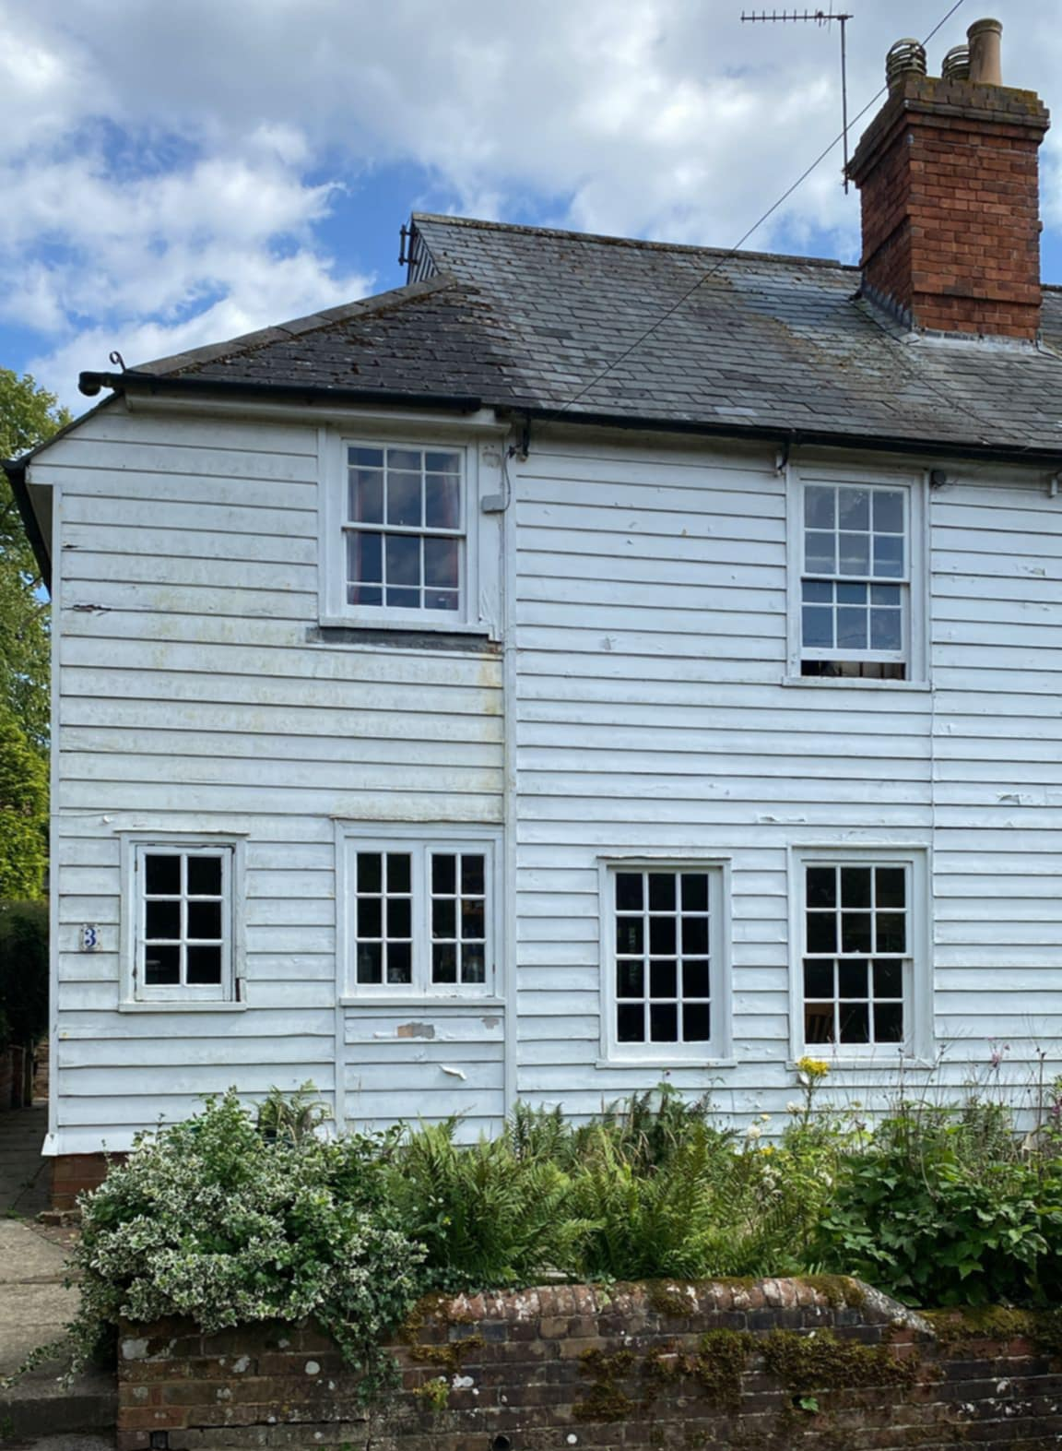
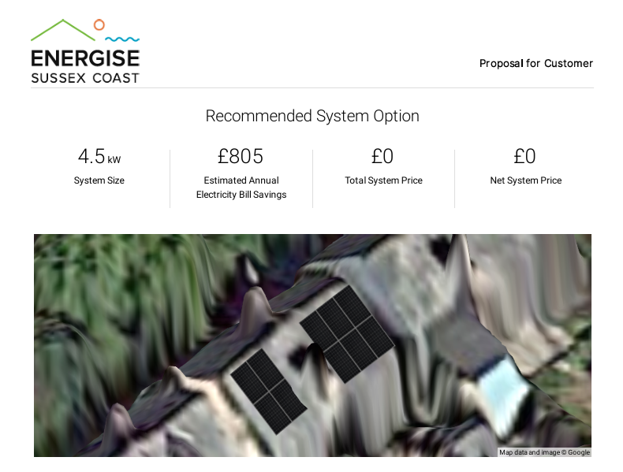
Illustration system
Notes:
*E.On and Octopus have smart tariffs that allow very cheap imports overnight
University of Oxford: https://discovery.ucl.ac.uk/id/eprint/10047969/1/McKenna%20PV%20self-consumption%20in%20UK%202018%2005%2008.pdf
45% self usage and 24% reduction in import

Slide 4
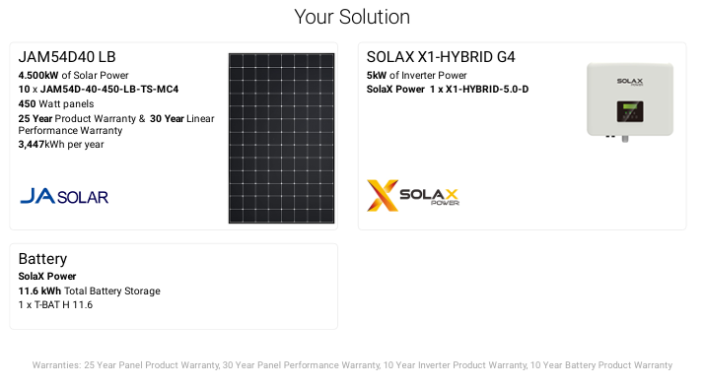
Designing your system
Notes:
*E.On and Octopus have smart tariffs that allow very cheap imports overnight
University of Oxford: https://discovery.ucl.ac.uk/id/eprint/10047969/1/McKenna%20PV%20self-consumption%20in%20UK%202018%2005%2008.pdf
45% self usage and 24% reduction in import

Slide 5
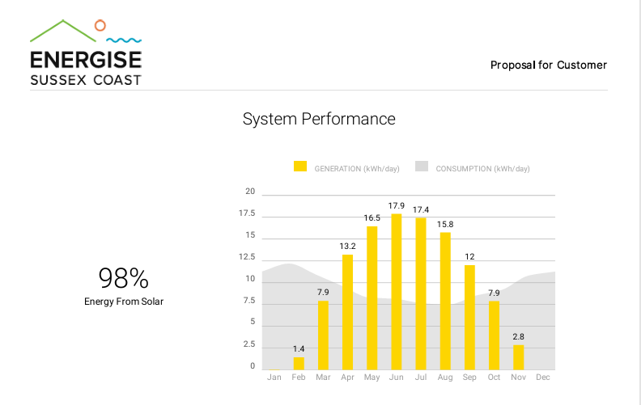
System performance
Notes:
*E.On and Octopus have smart tariffs that allow very cheap imports overnight
University of Oxford: https://discovery.ucl.ac.uk/id/eprint/10047969/1/McKenna%20PV%20self-consumption%20in%20UK%202018%2005%2008.pdf
45% self usage and 24% reduction in import

Slide 6
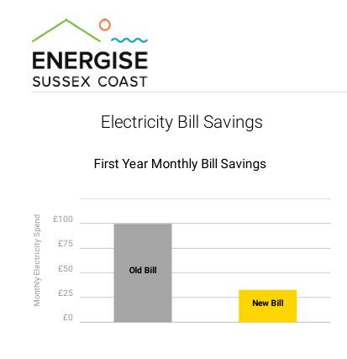
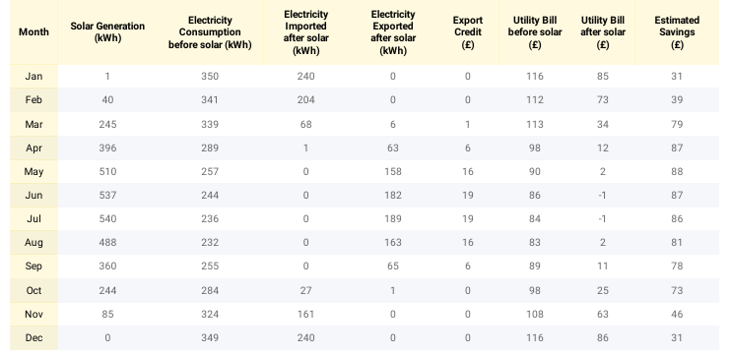
Savings each month
Notes:
*E.On and Octopus have smart tariffs that allow very cheap imports overnight
University of Oxford: https://discovery.ucl.ac.uk/id/eprint/10047969/1/McKenna%20PV%20self-consumption%20in%20UK%202018%2005%2008.pdf
45% self usage and 24% reduction in import

Slide 7

Funding
Savings
Extending your mortgage
Mortgage provider incentives
Solar company financing options
Ethical loan from Parity Trust
ECO4/ Warm Homes Local Grant
Solar subscriptions
Notes:
PASS TO HELEN
Advice service: A range of free services offered to residents of East Sussex includes support with – Problem Bills  Energy & Water Debt  Saving Energy  Accessing Grants  Draught proofing  & More…
Home visits: Free home visits for energy advice to ensure heating systems are working efficiently and economically.
Assessing insulation and accessing funding for this.
Support in applying for funded replacement or repairs to broken boilers and white goods.
Energy Champions – volunteers
Volunteer programme to support community action in East Sussex
Retrofit Service:
Retrofit Assessment
Whole house energy plans
Thermal imaging
Technical advice & guidance
EPC+ (EPC followed by an energy advice appointment)
Damp surveying (coming soon!)
Solar for community buildings:
Support provided to community groups in the south-east wishing to set up a solar project.
This includes all the technical, project management and financial services needed for a community solar project.
Crowhurst solar farm
Community Decarbonisation
Community decarbonisation plans
Community engagement events
Community campaigns
Free installation of energy efficient draught-proofing.

Slide 8
Choosing an installer
Get recommendations from others
Make sure MCS registered
Ask about aftersales support and length of warranties
Carefully compare quotes
Check the ethical source of the panels
Beware of too-good-to-be-true claim and scams
Notes:
*E.On and Octopus have smart tariffs that allow very cheap imports overnight
University of Oxford: https://discovery.ucl.ac.uk/id/eprint/10047969/1/McKenna%20PV%20self-consumption%20in%20UK%202018%2005%2008.pdf
45% self usage and 24% reduction in import

Slide 9
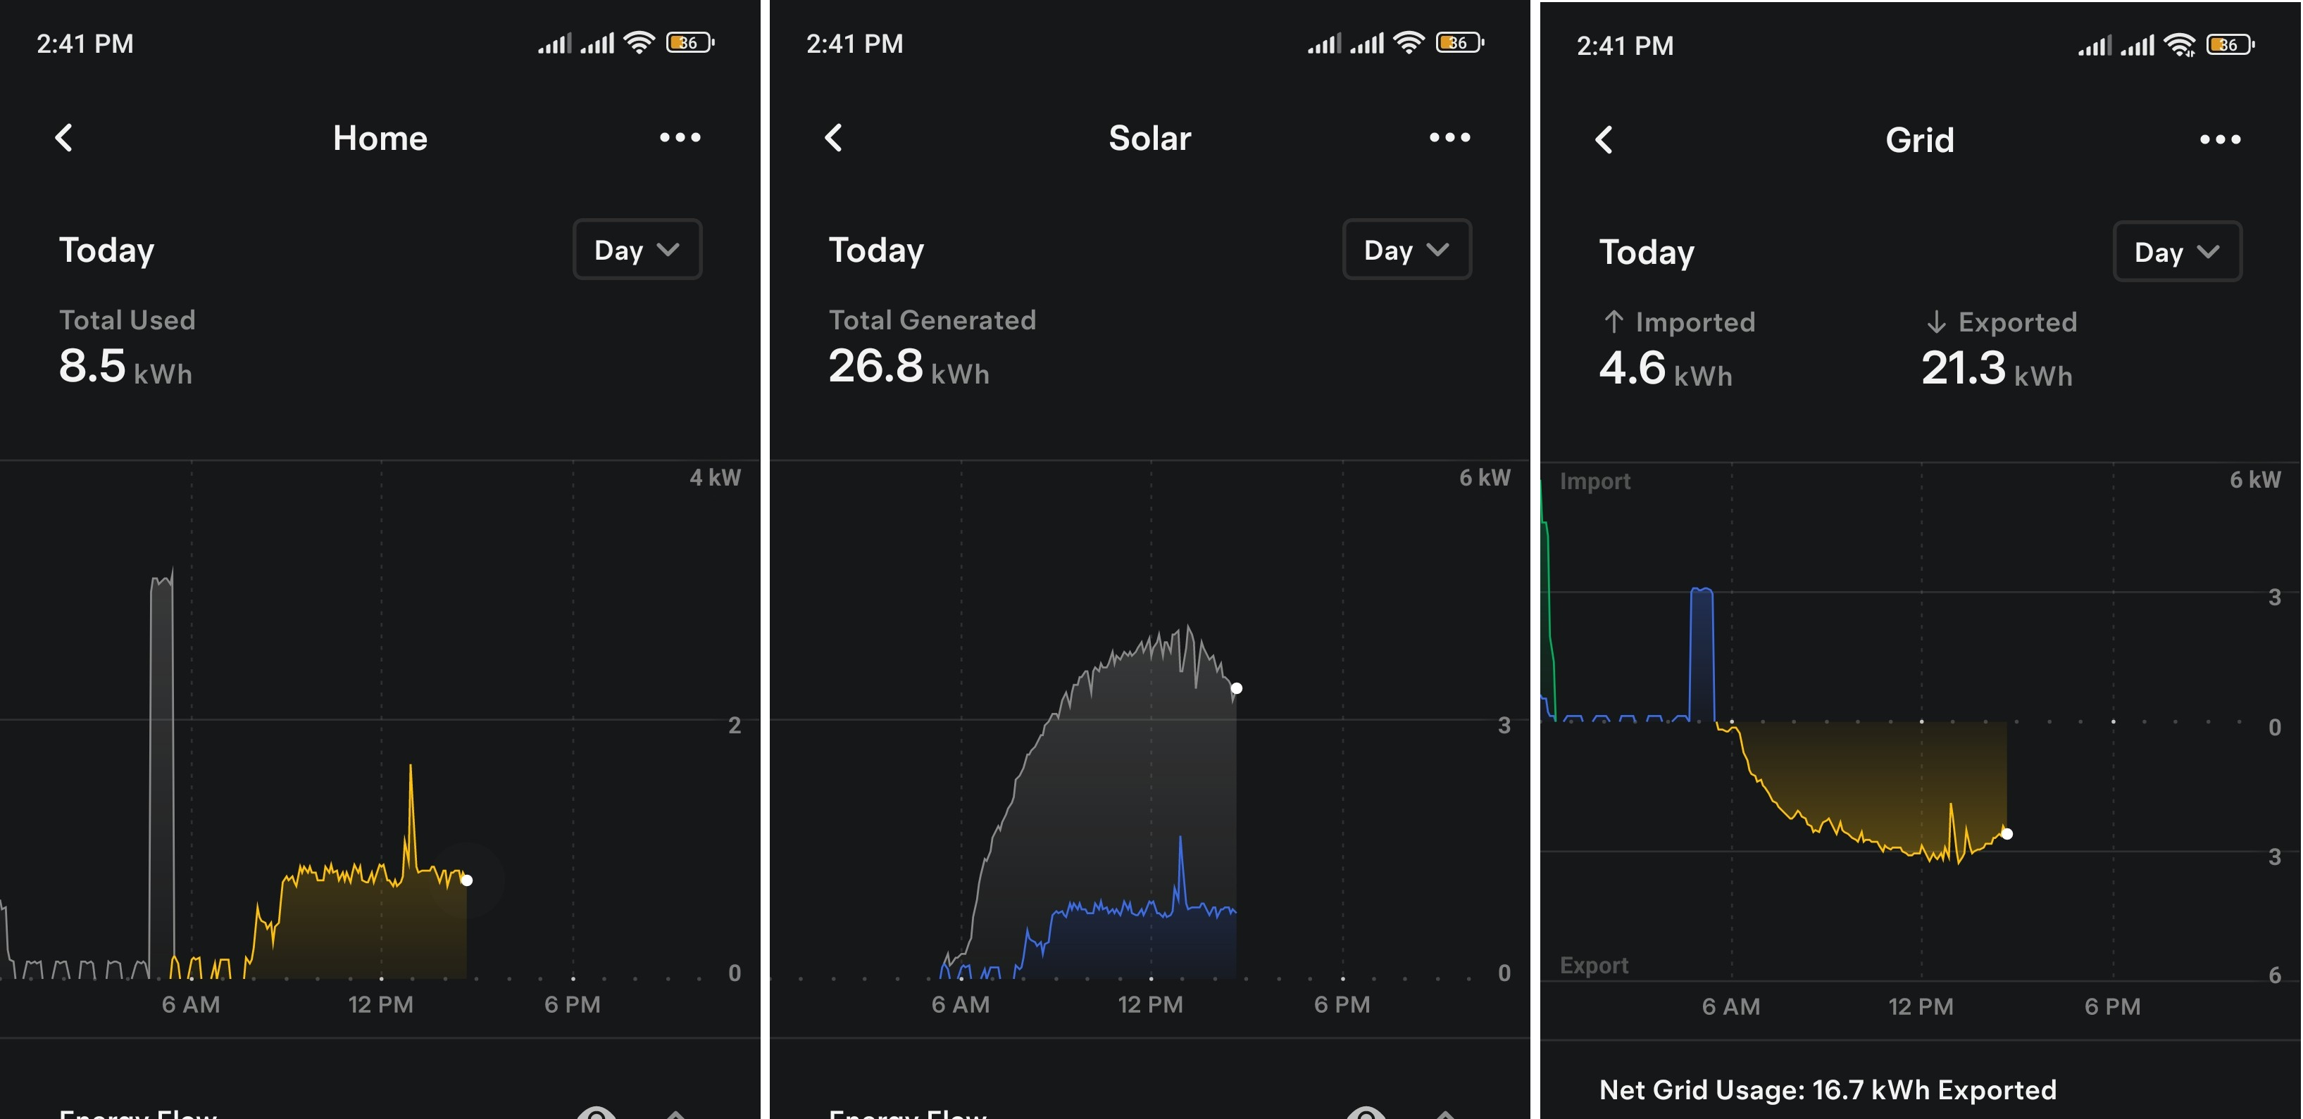
Making the most of your system
Prioritise using the electricity yourself - using your own generated power will give the greatest financial and environmental benefit.
Sell to the grid - you need to sign up with an energy company who will buy the electricity you don't use. This will be a separate tariff (and price) from the one where you buy energy and can be with a different company (although the best deals are to sell and buy energy from the same supplier).
Notes:
*E.On and Octopus have smart tariffs that allow very cheap imports overnight
University of Oxford: https://discovery.ucl.ac.uk/id/eprint/10047969/1/McKenna%20PV%20self-consumption%20in%20UK%202018%2005%2008.pdf
45% self usage and 24% reduction in import

Slide 12
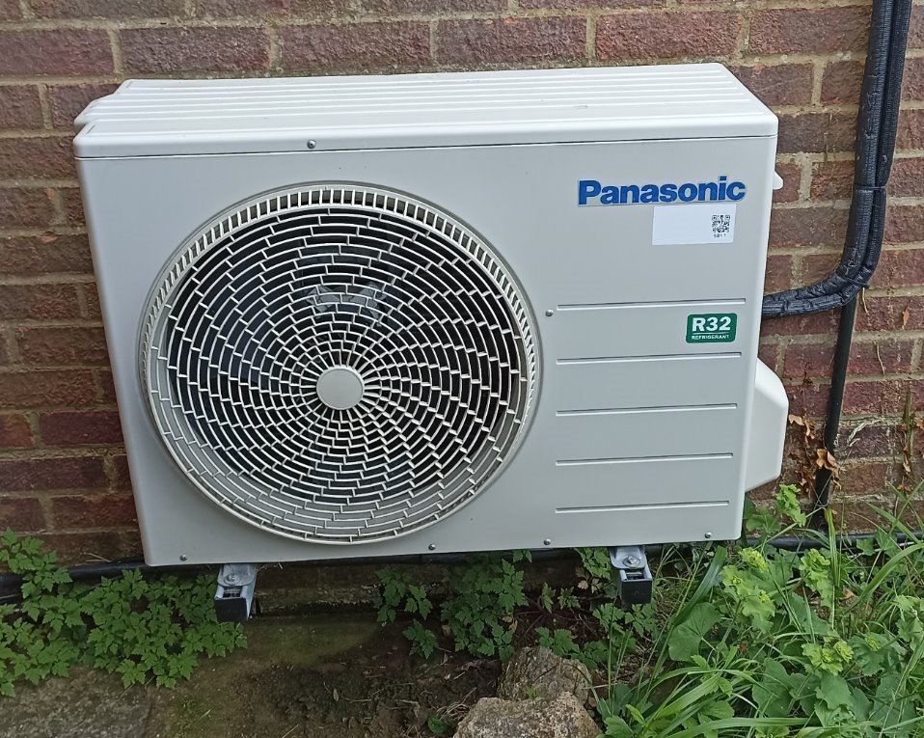
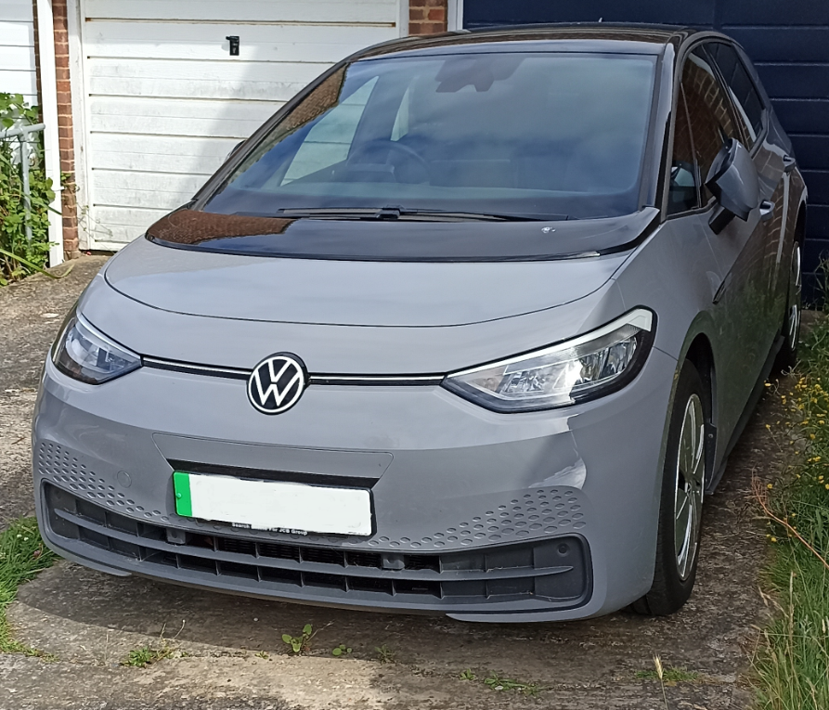
Making the most of your system
Get smart – combining solar with other low carbon technologies (e.g. heat pumps, electric cars) allows you to offset their running costs and access heat pump and EV tariffs that offer significantly cheaper rates during off peak times (typically the middle of the night).
Notes:
*E.On and Octopus have smart tariffs that allow very cheap imports overnight
University of Oxford: https://discovery.ucl.ac.uk/id/eprint/10047969/1/McKenna%20PV%20self-consumption%20in%20UK%202018%2005%2008.pdf
45% self usage and 24% reduction in import

