Slide 1
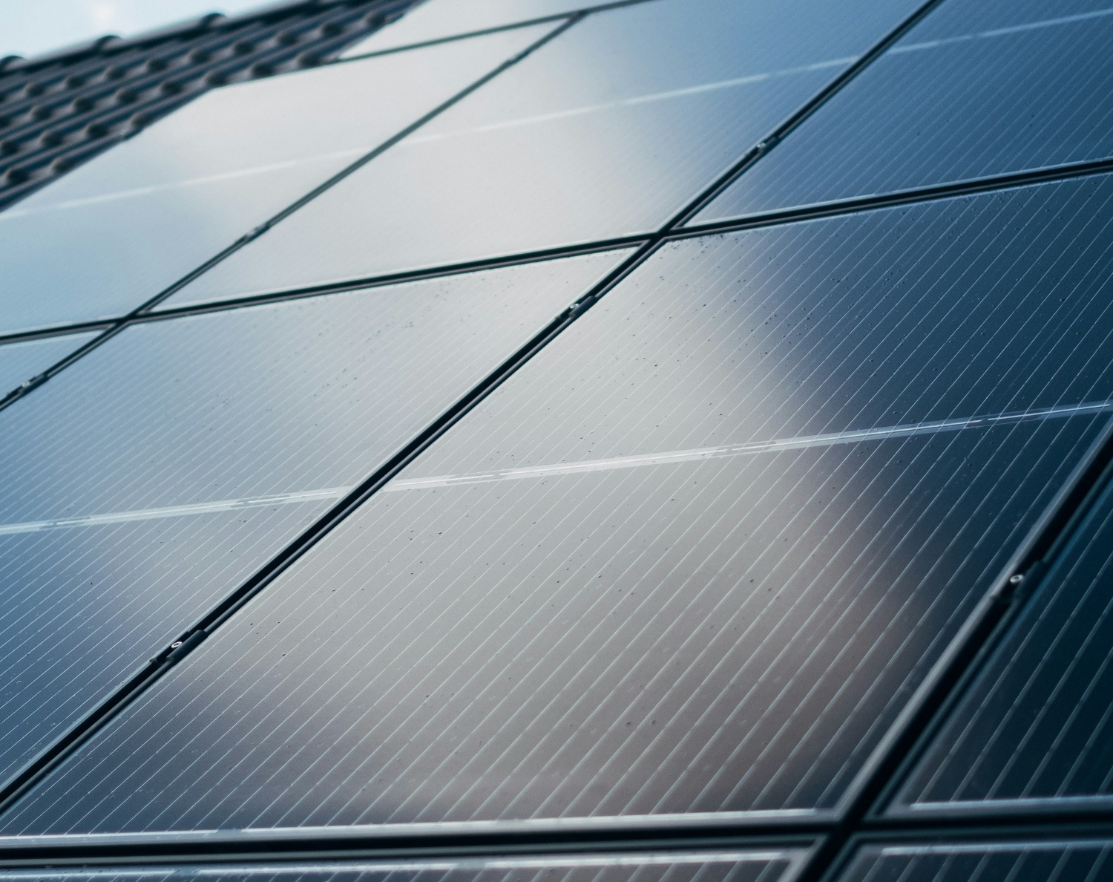
USE IT OR LOSE IT! Making the most of your Solar System
Lindsey Reed

Slide 2
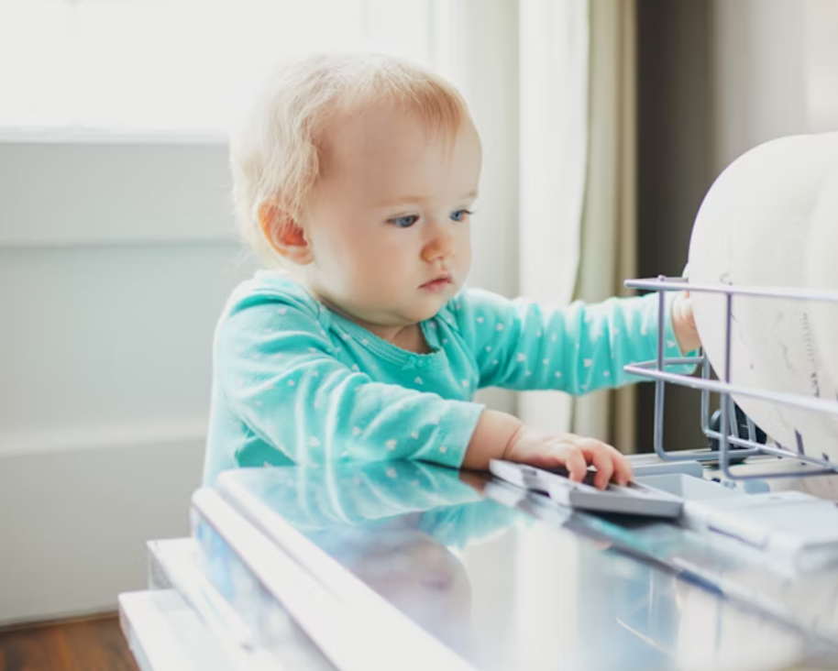
When do you put your dishwasher on?
When the sun is shining!
= free energy!

Slide 3
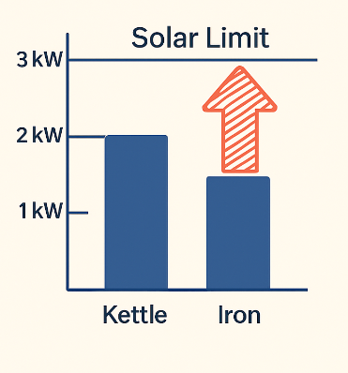
Let’s Play USE IT OR LOSE IT! A solar-savvy game to save you money
Why Does Wattage Matter?
Think “Smart Solar” and avoid paying for extra energy from the grid
Round 1:
Which uses the most power?
A) Washing Machine | (max) 2.0kW
B) Iron | 2.4kW
C) Kettle | 3.0kW
D) Toaster | 1.5kW
w/machine toaster

Slide 4
Round 2:
Stack or Stagger?
(Stack = using appliances at the same time
Stagger = use appliances at different times)
Dishwasher & Washing Machine
Toaster & Radio
EV Charger & Immersion Heater
TV & Phone Charger
Why Does this Matter?
To be Solar Savvy, change your habits when you use various appliances.

Slide 5
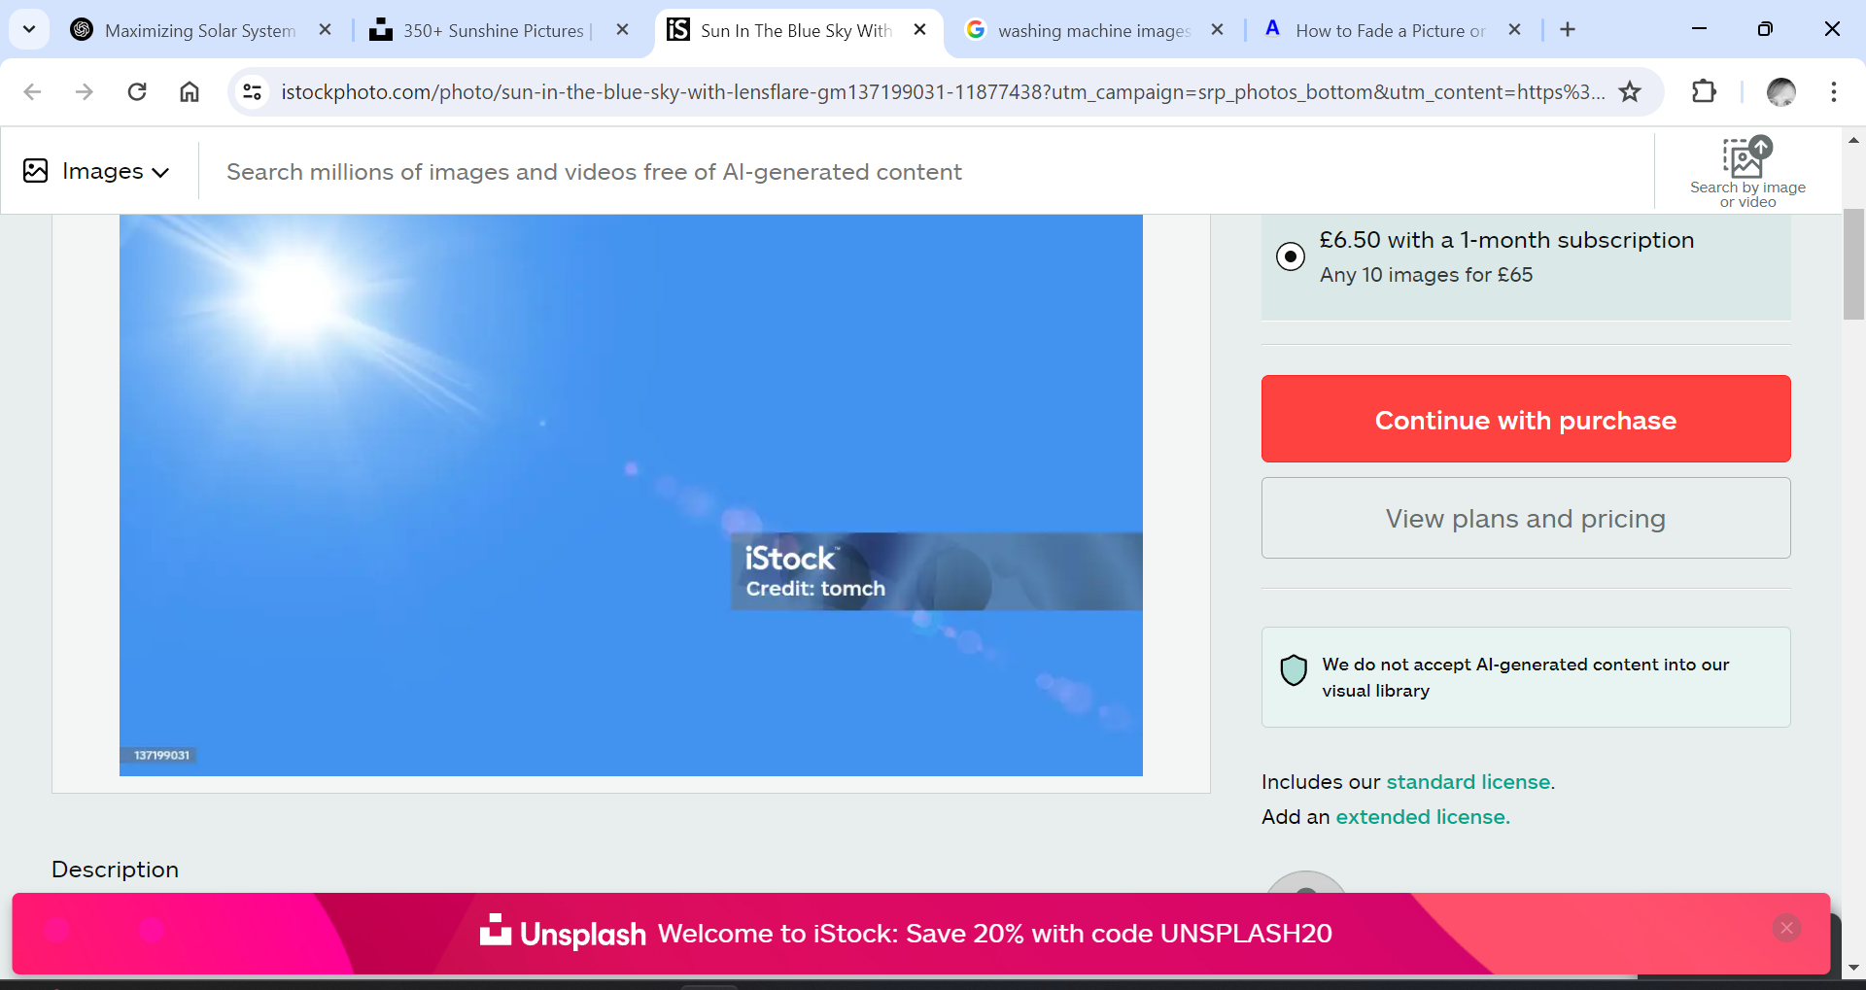
Round 3: Use It, Store It, or Lose It?
Where Does Extra Solar Go?
It’s a sunny day, but no one’s home. What happens to your extra solar energy?
A) Lost forever B) Stored in a battery C) Exported for pennies
All can happen– but you want B or C
And B is most effective
Why Does a Battery Help?
Let’s find out more….

Slide 6
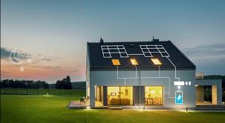
Why a Battery Matters
No Battery | With Battery
→ Sell extra to Energy Co. for 5–15p → Buy back from Energy Co. for 25–30p | → Store it now → Use it later (TV, lights, cooking) → Still have energy during power cuts
A battery = Your own power station

Slide 7
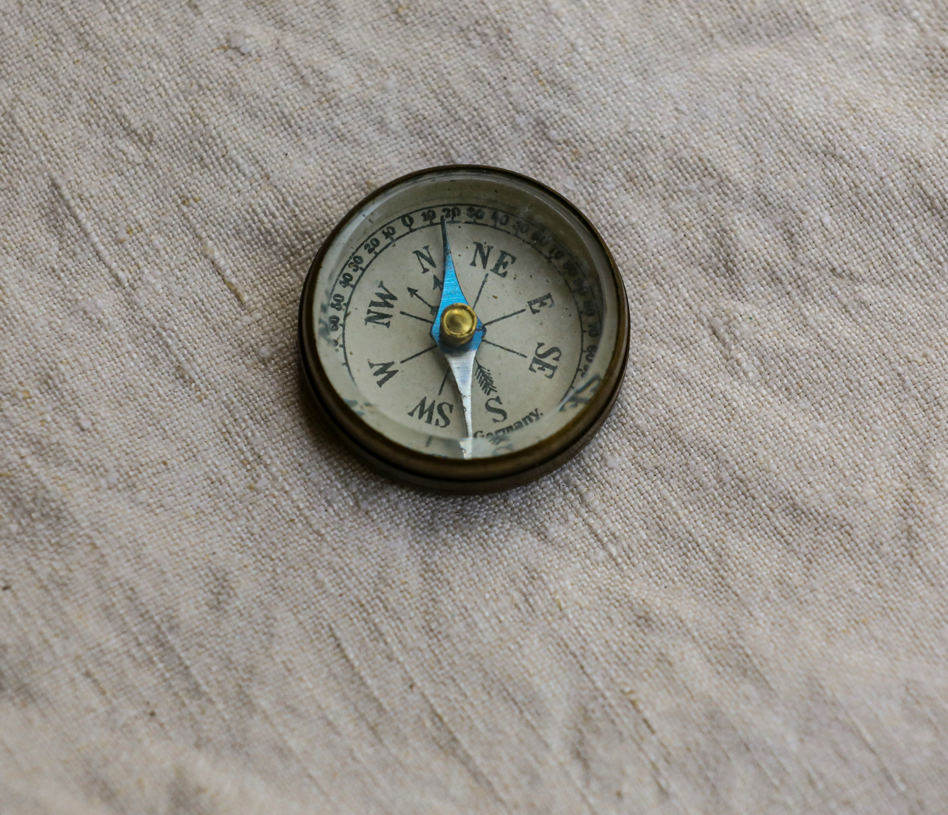
Bonus Tip 1:
Direction of Solar Panels v Time to Use
East = Morning power
South = Midday power
West = Afternoon power
*Out for the day? Use the Time Delay function

Slide 8
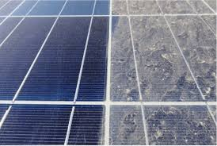
Bonus Tip 2:
Clean Solar Panels
Dirty/shaded panels = 10–20% energy loss
Clean every 1–2 years
Check for shadows from growing trees

Slide 9

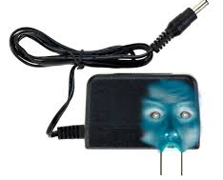
Bonus Tip 3:
Stop the Vampire Loads
Devices that suck power even on standby:
TVs
Routers
Alexa
Mobile chargers
*Use smart plugs or switch off at the wall

Slide 10

Let’s Recap
You’ve Got the Power — Use It or Lose It!
☀️
Be Savvy
🧼
Keep Panels Clean
🕐
Time it Right

